Slide 1
HAND GESTURE RECOGNITION
ARSHDEEP SINGH TAKKAR
SANAMDEEP SINGH ANAND

Slide 2
Flow of presentation
Introduction
Architecture
Camera Module
Skin extraction
Morphology
Detection Module
Contour Extraction
Region of interest extraction
Detection

Slide 3
Flow of presentation
Interface Module-Applications
Future Improvements
Credits
Conclusion

Slide 4
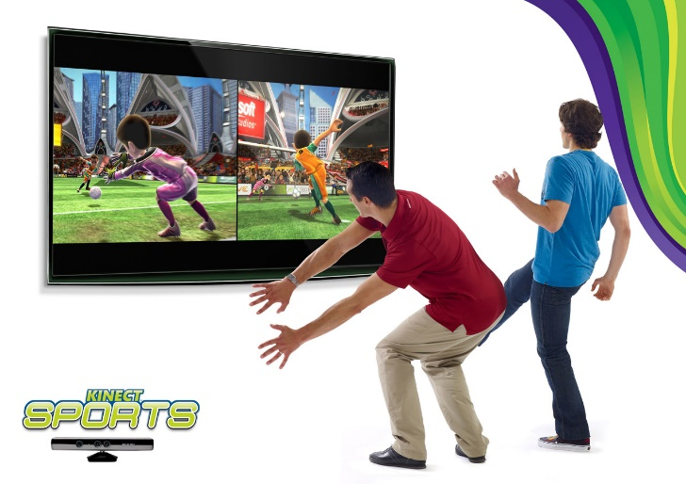
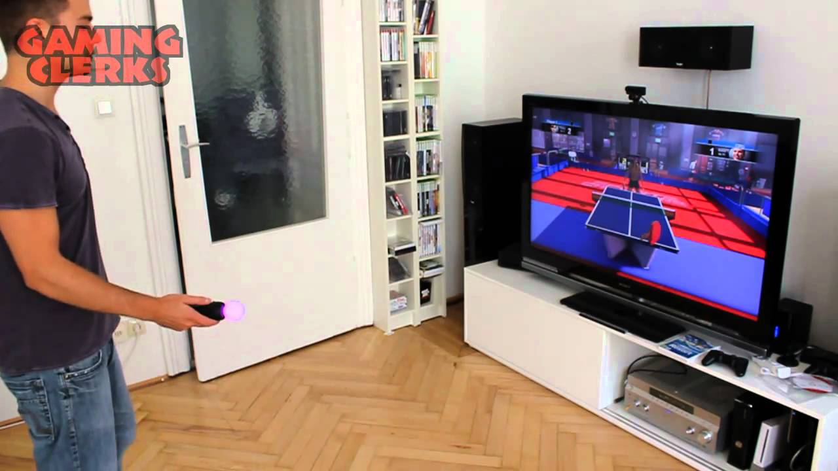
INTRODUCTION
Human Computer interaction exists ubiquitously everywhere
For example: Popular motion controllers such as Nintendo Wii, Playstation Move and Xbox Kinect
Problem –Costly and Limited to a gaming console only

Slide 5
INTRODUCTION
Implemented a simple but efficient method that allows robust and fast hand tracking despite Complex background and motion blur
Our method only requires a simple plug and play camera making the process cost efficient

Slide 6
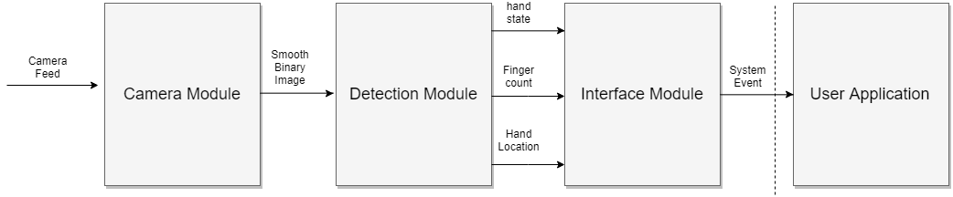
System Architecture

Slide 7
CAMERA MODULE
Skin color Extraction
Morphology Operations And Image Processing
Cam feed
Skin detection
Morphology Operation

Slide 8
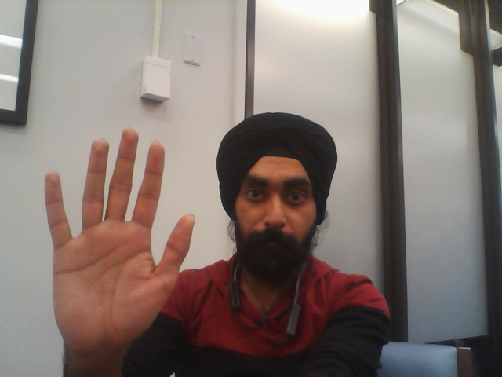
Original Image

Slide 9
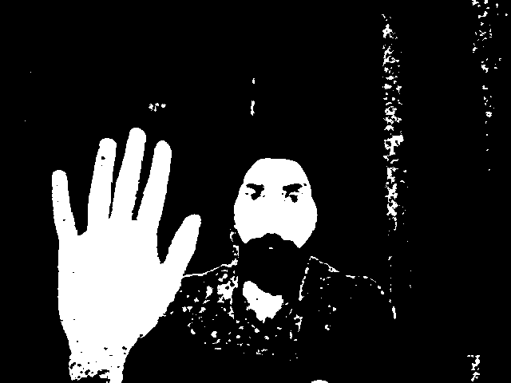
Skin Color Extraction
YCrCb Color ranges best .
The color value chosen is
54 ≤ Y ≤ 163
131 ≤ Cr ≤ 157
110 ≤ Cb ≤ 135 where:- Y,Cr,Cb=[0,255]

Slide 10
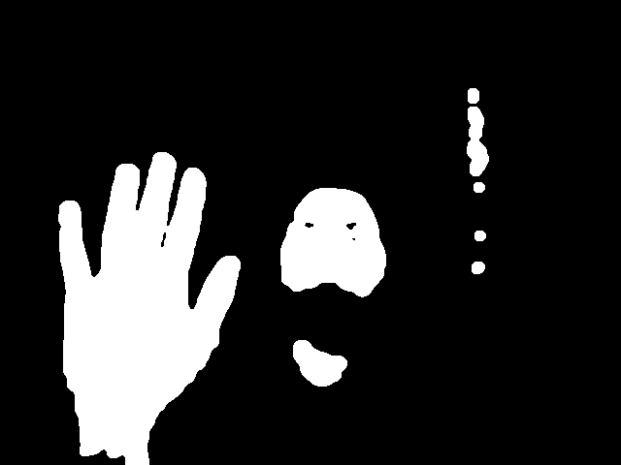
Image Morphology
we apply the Opening operator (erosion followed by dilation) after skin extraction.
After this we apply dilation to remove any holes in the detected region

Slide 11
Detection Module
extract information related to hand

Slide 12
Approach Followed
1.Contour Extraction And Polygon Approximation
2.Extracting region of interest using maximum inscribed circle
3.Region Of interest and finding minimum enclosing circle
4.Convex hull and Convexity defects extraction

Slide 13
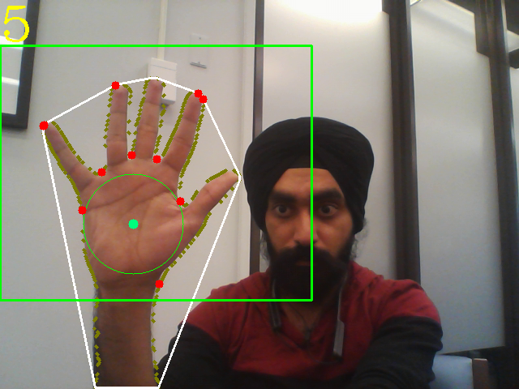
1.Contour Extraction And Polygon Approximation
Perform blob pruning to get rid of contours with very small areas
Polygon Approximation on the extracted contour to make it more suitable for shape analysis present in the next step.

Slide 14
2.Palm center and radius determination
For further calculations, we limit the region of interest around hand only
We find the maximum inscribed circle of the detected contour
We use the coordinates of the center and the radius to limit the search.

Slide 15
3.Region Of interest and finding min enclosing circle
Contour Extraction And Polygon Approximation performed again
Min enclosing circle and its radius on this new contour is calculated
Max inscribed circle is also determined
These parameters will be used later for gesture recognition

Slide 16
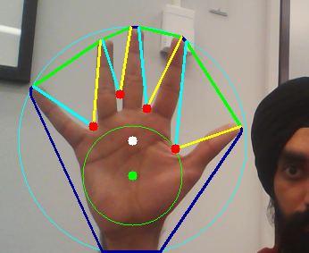
4.Convex hull and Convexity defects extraction
This information is used to characterize hand
Convex hull are the crests on the top of fingers
Convexity defects are the troughs between the fingers web

Slide 17
Application

Slide 18
Counting number of fingers
By analyzing contour’s characteristics, we can determine the precise fingers locations. It should meet the criteria as follows:
Depth of each convexity defect must be longer than palm center radius(r_{a}) but shorter than min enclosing radius(r_{b}) [r_{a} ≤ l_{d} ≤ r_{b}]
Angle (θ(a))between start point(p_{s}) and end point(p_{e}) must be less than 90 degrees [ θ(a) ≤ 90 degree]

Slide 20
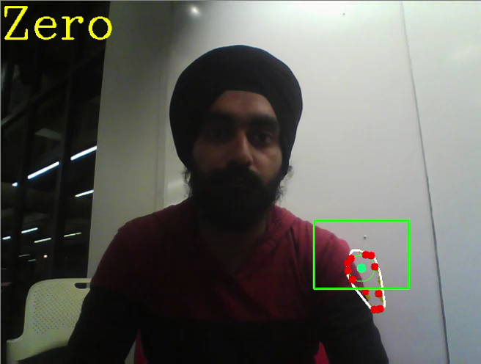
Demo - Finger Counting

Slide 21
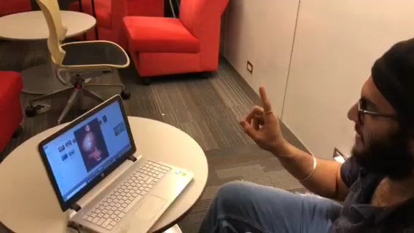
Demo - Image Swiping

Slide 22
Future Improvements
Performance improvements
Static background Subtraction
Face Removal
Functionality upgrade
Use Of Neural Networks to recognize larger variety of gestures

Slide 23
REFERENCES
https://nodedangles.wordpress.com/2010/05/16/measuring-distance-from-a-point-to-a-line-segment/
Hand Tracking and Gesture recognition System for human-Computer Interaction using low-cost hardware (Hui-Shyong Yeo,Byung-Gook Lee and Hyotaek Lim)
https://opencv.org/

Slide 24
Conclusion
A robust approach to hand detection and gesture recognition has been presented
Since this approach does not utilize any high cost hardware, there are few performance trade-offs
However, these trade-offs can be reduced to great extent by further development

Slide 25
QUESTIONS???

Slide 26
THANK YOU

